Slide 1

Sentiment Analysis of Financial and Blockchain News using NLP
Detailed Project Overview

Slide 2
Introduction
Purpose of the Project: To apply NLP techniques for sentiment analysis on financial and blockchain news data to derive insights that could influence decision-making and strategy development in these sectors.
Significance of Sentiment Analysis: Briefly describe how understanding sentiment can impact investment strategies, market response, and regulatory compliance.

Slide 3
Tools and Libraries Used
Pandas and NumPy
TensorFlow and Keras
NLTK
Scikit-learn
For data manipulation and numerical operations.
Natural Language Toolkit for text preprocessing tools.
For building and training advanced machine learning models.
For traditional machine learning models and evaluation metrics.

Slide 4
Data Collection and Preparation
Data Sources: We have extracted dataset from kaggle.
Initial Data Structure: No. of columns: 2 :
Day - to - day Financial News: Sentiment and News headline
Blockchain Financial News: News headlines related to blockchain

Slide 5
Data Preprocessing
Text Cleaning Techniques
Text Preprocessing
Removal of HTML tags via Beautiful Soup.
Normalization of accented characters using Unicode data normalization.
Expansion of contractions for a uniform text format.
Tokenization and Vectorization.
Stopword Removal.
Feature Engineering.

Slide 6

Naive Bayes Model:
Data Preparation: Padded sequences of integers representing text data are converted into text format for both training and testing sets. Text data is transformed into numerical vectors using `CountVectorizer`, with a maximum of 5000 features.
Model Training: A Multinomial Naive Bayes classifier is initialized and trained on the transformed training data (`X_train_count`) along with corresponding labels (`y_train`).
Prediction and Evaluation: Predictions are made on the test data (`X_test_count`) using the trained Naive Bayes classifier. Accuracy is computed by comparing predicted labels with actual labels (`y_test`).
Results: The accuracy of the Naive Bayes classifier (0.874) and the classification report are printed to the console for analysis.

Slide 7
Random Forest Classifier
Random Forest is an ensemble learning method primarily used for classification and regression. It operates by constructing multiple decision trees during training and outputs the class that is the mode of the classes (classification) or mean prediction of the individual trees.
Key features and reasons for using Random Forest include:
Robustness: It handles overfitting well, especially when dealing with large datasets.
Handling of Various Data Types: Effectively processes datasets with mixed types of features (numerical and categorical).
Feature Importance: Provides insights into which features are most important in making predictions.
The choice of Random Forest in this case appears to be due to its robustness and efficiency in handling classification tasks, and possibly to serve as a benchmark or baseline to compare the performance of other models like CNN, RNN, and LSTM in terms of
accuracy.

Slide 8
Convolutional Neural Networks (CNN)
CNNs are deep learning algorithms that are particularly powerful for processing data that has a grid-like topology, such as images. CNNs use a series of convolutional layers to capture spatial hierarchies in data. The reasons for their popularity include:
Word Embeddings: CNNs for text usually start with word embeddings (like Word2Vec or GloVe) which convert words into dense vectors. These embeddings capture semantic properties and context of words, providing a rich representation that serves as input to the CNN layers.
Automatic Feature Extraction: Eliminates the need for manual feature extraction, making them easier to train on large datasets.
CNNs are chosen probably due to their ability to automatically learn and generalize patterns from textual data, which is beneficial in high-dimensional datasets typical in text processing tasks.

Slide 9
RNN Model
1. Embedding Layer: Converts word tokens into dense vectors (embeddings).
Parameters: input_dim: Vocabulary size, output_dim: Embedding size (300),input_length: Maximum sequence length (30)
2. SpatialDropout1D: Introduces dropout to randomize entire 1D feature maps for regularization.
Parameters: rate: Dropout rate (0.2).
3. SimpleRNN Layer: A simple recurrent layer that maintains a memory of previous sequences.
Parameters: Number of units: 128, Activation: ReLU, dropout: 0.2 (regular dropout), recurrent_dropout: 0.2 (dropout applied between time steps) , return_sequences: True (keeps sequence structure)

Slide 10
RNN Model
4. GlobalMaxPooling1D: Reduces the sequence of outputs to a single maximum value for each feature map, producing a fixed-size output.
5. Dense Layer: Fully connected layer for further processing of features.
Parameters: Number of neurons: 64, Activation: ReLU.
6. Final Dense Layer with Sigmoid Activation: Provides a binary classification output.
Parameters: Number of neurons: 1, Activation: Sigmoid (for binary output).

Slide 11
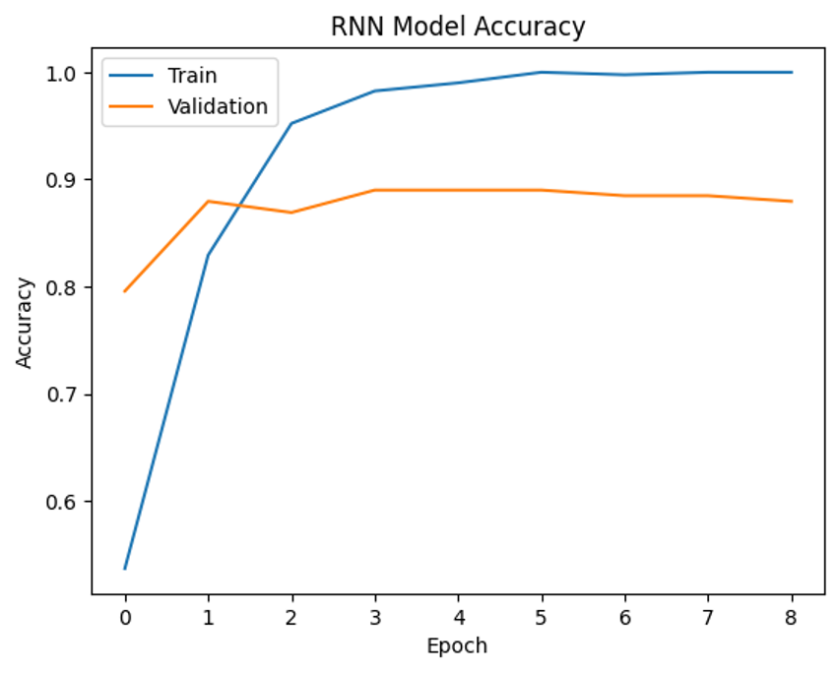
RNN Model Accuracy
RNN Accuracy: 91.93%
RNN Precision: 91.95%
RNN Recall: 91.91%
RNN F1-score: 91.92%
Confusion Matrix | positive | negative
positive | 364 | 36
negative | 30 | 388

Slide 12
LSTM Model
1. Embedding Layer: Converts word tokens into dense vectors (embeddings).
Parameters: input_dim: Vocabulary size (`vocab`), output_dim: Embedding size (`300`), input_length: Maximum sequence length.
2. LSTM Layer (First Layer): Captures long-term dependencies in sequential data.
Parameters: Number of units: 64, return_sequences`: True (keeps sequence structure)
3. LSTM Layer (Second Layer):Adds another LSTM layer to deepen the model's capacity for sequence processing.
Parameters: Number of units: 32, return_sequences`: False (reduces the output to a single vector).
4. Dropout Layer: Adds regularization by randomly setting some neurons to zero, reducing overfitting.
Parameters: Dropout rate: 0.1.
5. Dense Layer (First): Fully connected layer to process the features from previous layers.
Parameters: Number of neurons: 8, Activation: ReLU.

Slide 13
LSTM Model
6. Dropout Layer (Second): Further regularization to prevent overfitting.
Parameters: Dropout rate: 0.1.
7. Dense Layer (Second): Further processing of features with reduced dimensionality.
Parameters: Number of neurons: 4, Activation: ReLU.
8. Dropout Layer (Third): Additional regularization.
Parameters: Dropout rate: 0.1.
9. Final Dense Layer with Sigmoid Activation: Produces the final output for binary classification.
Parameters: Number of neurons: 1, Activation: Sigmoid.

Slide 14
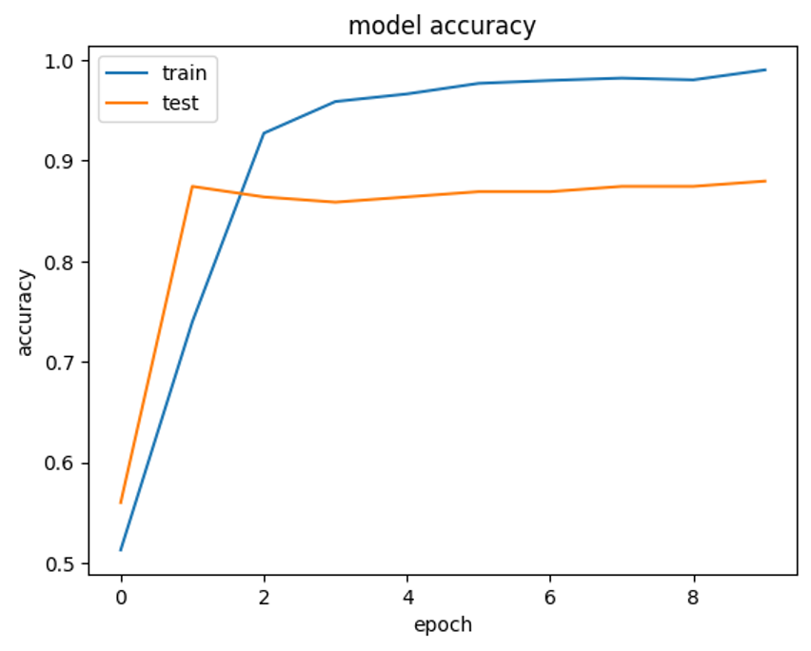
LSTM Model Accuracy
LSTM Accuracy: 91.08%
LSTM Precision: 91.13%
LSTM Recall: 91.12%
LSTM f1_score: 91.08%
Confusion Matrix | positive | negative
positive | 373 | 27
negative | 46 | 372

Slide 15
Model Development and Training
Overview of Models Used
Naive Bayes
Random Forest
Convolutional Neural Networks (CNN)
&
Recurrent Neural Networks (RNN)
LSTM
for baseline performance
for feature importance
for capturing sequence in text
recognition of temporal cnnection
Notes:
Atharvaa

Slide 16
Evaluation and Metrics
Accuracy, Precision, Recall, F1-Score
Model | Accuracy | Precision | Recall | F1-Score
Naive Bayes | 87.40% | 88% | 88% | 87%
Random Forest | 92.18% | 92% | 92% | 92%
CNN | 91.56% | 89% | 91% | 87%
RNN | 91.93% | 91.95% | 91.91% | 91.91%
LSTM | 90.22% | 90.21% | 90.22% | 90.22%
Notes:
Atharvaa

Slide 17
Then why do we still chose RNN?
Evaluation:
The comparison between the all the models for the financial news dataset showcases interesting findings in terms of testing accuracy.
Even though random forest has the highest accuracy, but considering other evaulation parameter rnn seems like a better choice so we choice rnn for are predication modeling
Blockchain dataset contains only one column "News Headlines".
What makes us chose it?
So we used Random forest as our baseline for other models.
But RNN is chosen since it specifically used for text classification
It can handle sequencial data like financial headlines, where understanding the context and the words is the key to predication.
Good at contextual memory, and its crucial when meaning of a word or phrase can change example “ good” & “ not good”.
Flexibility to manage inputs of variable lengths, vital for processing financial headlines as there length can be variable

Slide 18
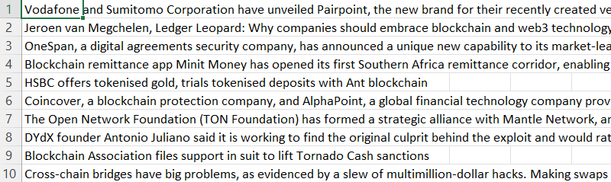
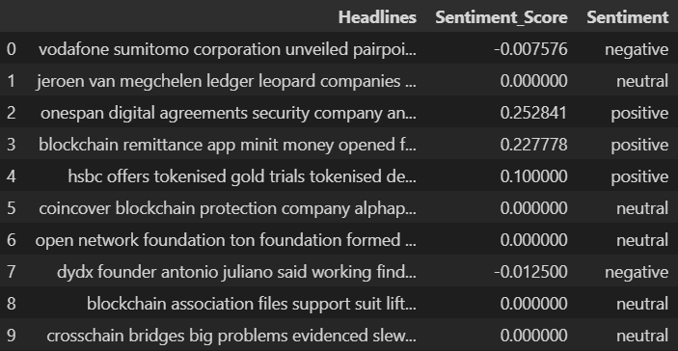
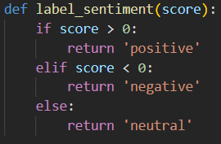
Blockchain Dataset
Unlabelled blockchain dataset
TextBlob
Labelled Dataset

Slide 19
RNN Model
1. Embedding Layer: (None, 30, 300)
2. SpatialDropout1D: (None, 30, 300)
3. SimpleRNN Layer: (None, 30, 128)
4. GlobalMaxPooling1D: (None, 128)
5. Dense Layer: (None, 64)
6. Final Dense Layer with Sigmoid Activation: (None, 1)

Slide 20
Accuracy
Blockchain RNN Accuracy: 87.50%
Blockchain RNN Precision: 87.50%
Blockchain RNN Recall: 87.76%
Blockchain RNN F1-score: 87.48%

Slide 21
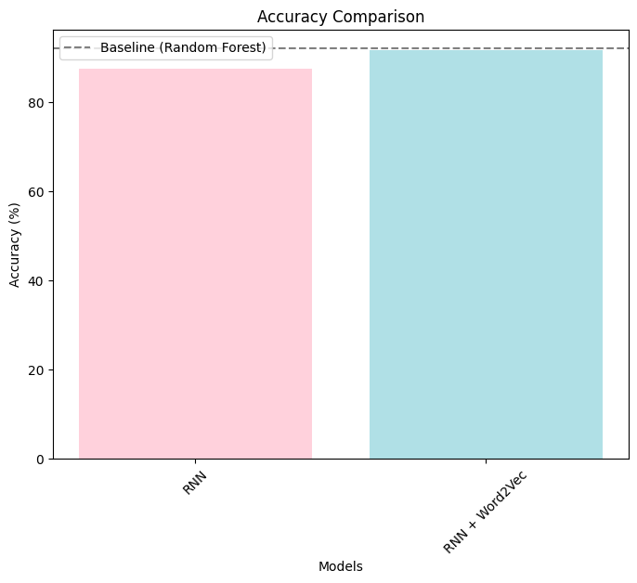
Word2Vec
RNN Blockchain Word2Vec Model:
Train Accuracy: 100.00%
Test Accuracy: 91.67%
The model with Word2Vec embeddings
outperformed the RNN model without
Word2Vec, indicating that the learned
Word2Vec representations contributed
positively to the model's generalization
capabilities.

Slide 22
Conclusion
Training Phase: Both models have performed exceptionally well during training, but the RNN with Word2Vec embeddings reached a perfect accuracy on the training set, which may indicate that the Word2Vec embeddings effectively captured relationships within the Blockchain dataset, making it easier for the model to learn.
Testing Phase: In the testing phase, the model with Word2Vec embeddings outperformed the RNN model without Word2Vec, indicating that the learned Word2Vec representations contributed positively to the model's generalization capabilities. It could understand the semantics better, enabling improved predictions on unseen data from the test set.
Hence, we have successfully performed Sentiment Analysis on Financial news. Out of all the models, RNN with Word2Vec is proved to produce the best results.

